Slide 1
Restaurant Recommendation system using ML
​
Swapnil Patil 112115107
Praveen Nayakar 112115117
Mir Tahfiz Hafiz 112115090

Slide 2
AGENDA
Introduction​
Primary goals
​Areas of growth
Timeline
​Summary​

Slide 3
Introduction
Recommendation systems are a type of information filtering systems because they improve the quality of search results and provide elements that are more relevant to the search item or that are related to the search history of the user.
These are active information filtering systems that personalize the information provided to a user based on their interests, relevance of the information, etc.

Slide 4
two types of recommendation systems: Content-based filtering Collaborative filtering

Slide 5
Collaborative Filtering: | Content-Based Filtering:
User-Based Collaborative Filtering: This method recommends items to a user based on the preferences and behavior of users who are similar to them. . It identifies users with similar item preferences and suggests items that those similar users have liked. | Content-based recommendation systems use information about the items and a user profile to make recommendations. These systems analyze the content and attributes of items and match them to the user's historical preferences.
Item-Based Collaborative Filtering: Instead of focusing on user similarity, this approach identifies similarities between items. It recommends items similar to those the user has already shown an interest in.

Slide 6
Methodology
Data Preprocessing
Text Preprocessing
TF-IDF Vectorization

Slide 7
1. Data preprocessing
Deleting Unnecessary Columns
Removing the Duplicates
Remove the NaN values from the dataset
Changing the column names
Data Transformations
Data Cleaning
Adjust the column names

Slide 8
2.Text Preprocessing
Lower casing
Removal of Punctuations
Removal of Stopwords
Removal of URLs
Spelling correction

Slide 9
TF-IDF Vectorization
TF-IDF (Term Frequency-Inverse Document Frequency) vectors for each document. This will give you a matrix where each column represents a word in the general vocabulary (all words that appear in at least one document) and each column represents a restaurant, as before.
TF-IDF is the statistical method of assessing the meaning of a word in a given document.

Slide 10
TF-IDF = Term Frequency (TF) * Inverse Document Frequency (IDF)
Term Frequency
Inverse-Document Frequency
tf(t,d) = count of t in d / number of words in d
This measures the frequency of a word in a document. This highly depends on the length of the document and the generality of the word.
idf(t) = N/df
IDF is the inverse of the document frequency which measures the informativeness of term t. When we calculate IDF, it will be very low for the most occurring words such as stop words. This finally gives what we want, a relative weightage.

Slide 11
workflow
Create a list to put top restaurants
Find the index of the hotel entered
Find the restaurants with a similar cosine-sim values and order them from biggest number.
Extract top 30 restaurant index with a similar cosine-sim value
Names of top 30 restaurants
Creating the new data set to show similar restaurants
Creating the top 30 similar restaurants with some of their columns
Drop the same named restaurants and sort only the top 10 by the highest rating.

Slide 12
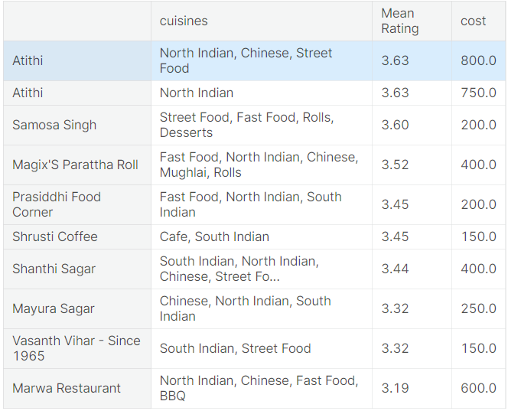
Results
TOP 10 RESTAURANTS LIKE Pai Vihar WITH SIMILAR REVIEWS:

Slide 13
THANK YOU

